Slide 1

Analysis of Stand-Up Comedians
The Science behind the Art
Kedar Godbole
Alex Imhoff
Tara Mary Joseph
Jyoti Kumari
Aman Sharma
MSBA Fall 2024

Slide 2

Agenda
Overview and Purpose
Data and the YouTube API
EDA - Text and Audio
Modeling - Text and Audio
Combining Text and Audio Models
Conclusion, Insights, and Future Scope
Q&A

Slide 3
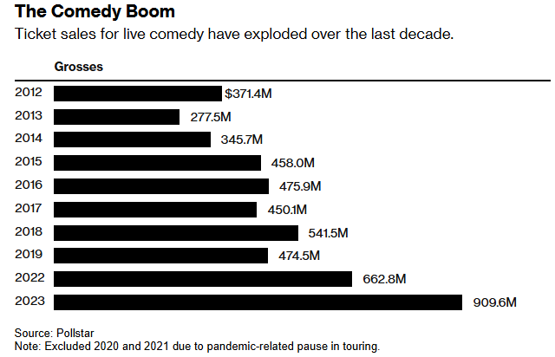

Overview and Purpose
Stand-Up Comedy industry tripled over the past 10 years
More opportunities for comedians to get noticed and earn revenue through YouTube, Netflix specials, podcasts, etc.
However, talented comics with good content continue to struggle with delivery
Notes:
Source: https://www.bloomberg.com/news/newsletters/2024-05-05/stand-up-comedy-has-tripled-in-size-over-the-last-decade

Slide 4
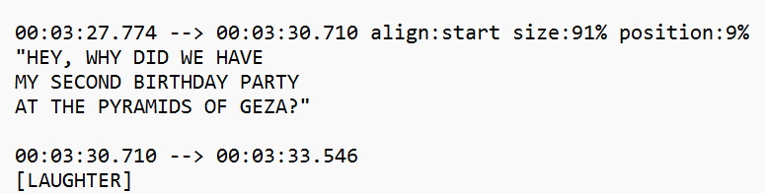


Using the YouTube-DL API to Gather Data
YouTube-DL API allows for caption and audio downloading
Clean-up “extra” in the captions
Identify instances of laughter/cheering
APIs used:
Youtube-transcript-api → Captions & Audio
Pydub → convert raw data to mp3 audio
Notes:
Kedar

Slide 5

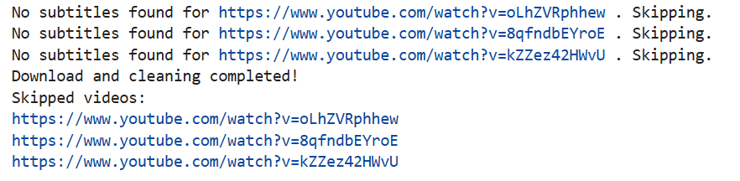
YouTube Data - Challenges
Manual vs Automatic Captions
Swear Words
Converting to Usable Format (Audio)
Timestamps
Language (American vs British vs Australian)
3rd Party API - No Association with YouTube
Notes:
Kedar
-

Slide 6
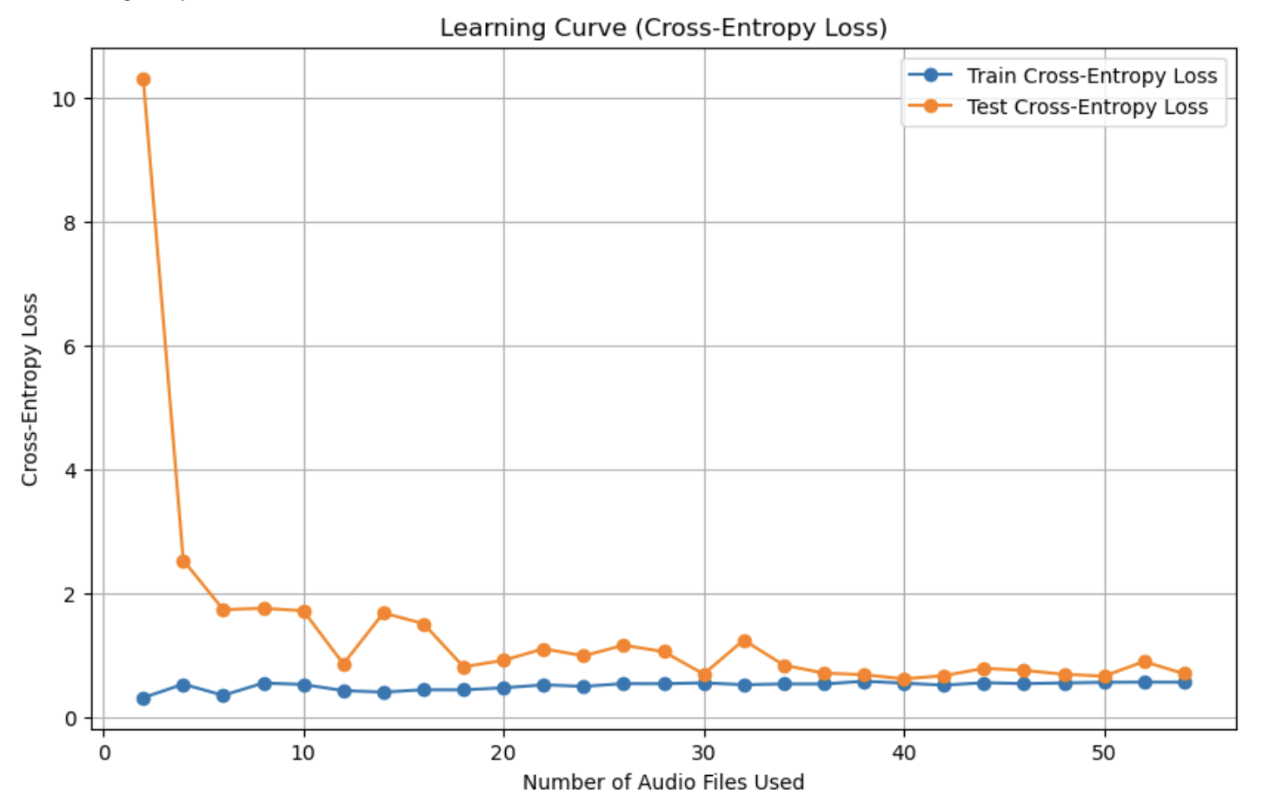
Learning Curves
Notes:
Similar plot for the caption learning curve

Slide 7
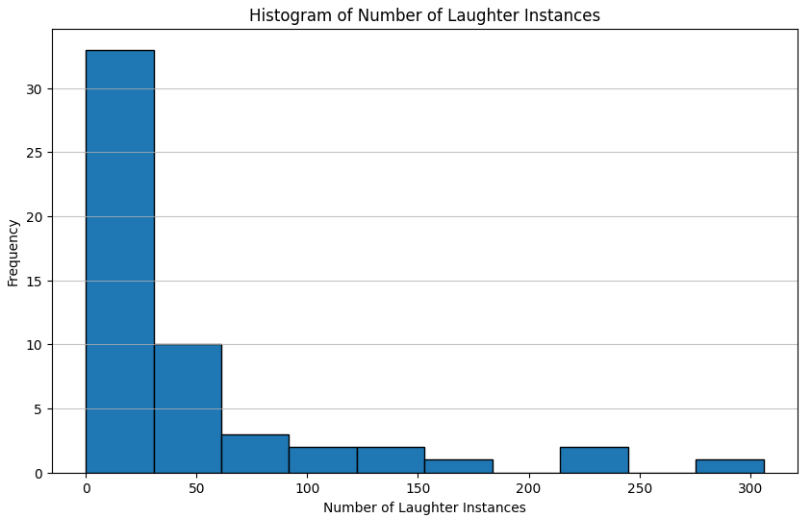
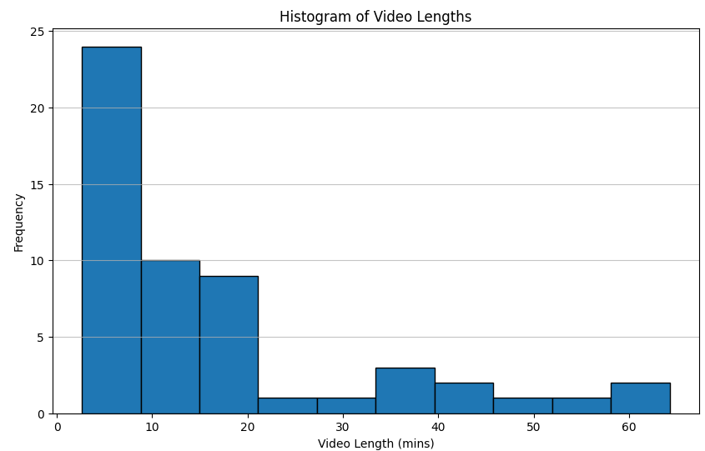
EDA - Laughs and Video Lengths
~46-47 laughs per Video
Avg Vid Length is ~16-17 mins

Slide 8
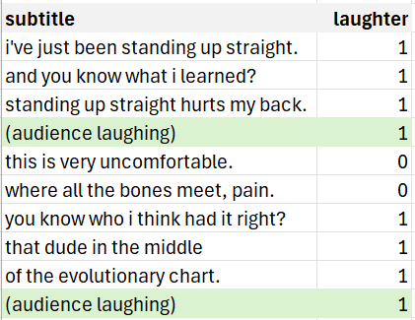
Text Analytics
Our target variable - ‘laughter’ is the row that contains the laughter annotation and the previous three lines which act as context
“the sentence immediately preceding the marker was considered the “punchline”, while the three sentences preceding the punchline were considered the “setup”. ”
Context
Context
Methodology inspired from : Analyzing Humor by Turano et. al. (2022)
An example from video ‘A Man Of Average Intelligence.’ - Zoltan Kaszas
Notes:
Kedar

Slide 9
Text Analytics
A simple approach with feature engineering based on the text of the subtitles
Phonetic - alliteration , assonance , consonance
Ambiguity - sense combination , sense farthest , sense closest, average senses
Humor - entity types, antonyms, entity count , profanity
Similarity - cosine similarity between pairwise vectors (based on lookback)
Sentiment - sentiment compound score
Punctuations - exclamations , question marks , pauses
Notes:
Kedar

Slide 10
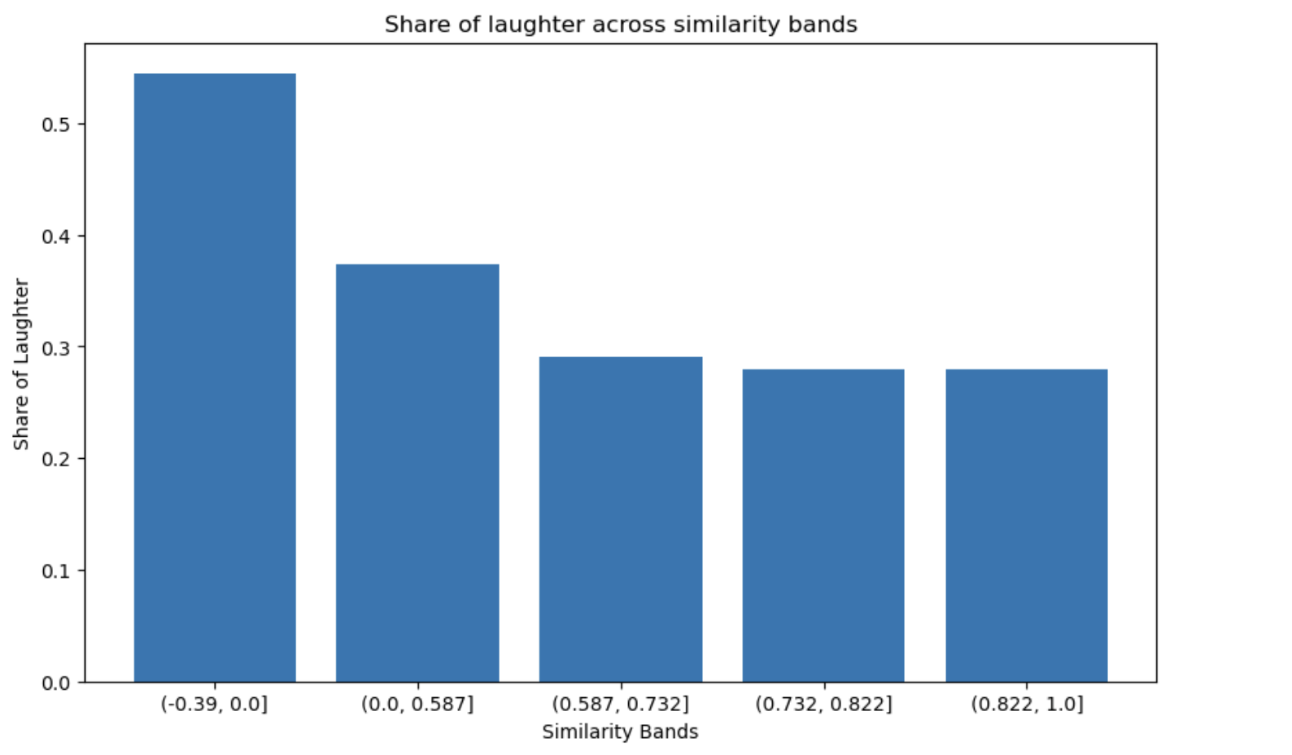
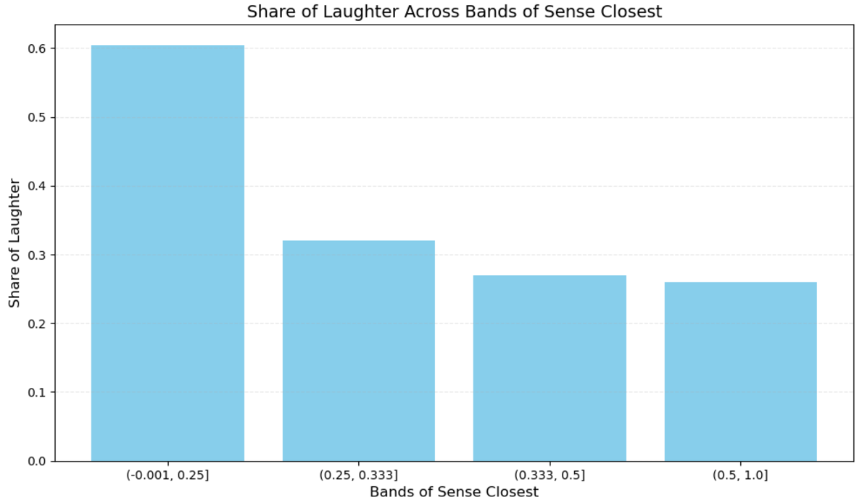
Text Analytics - EDA
Low Similarity, Big Laughs
The role of "unexpectedness" or "contrast" in driving laughter
Notes:
Kedar

Slide 11
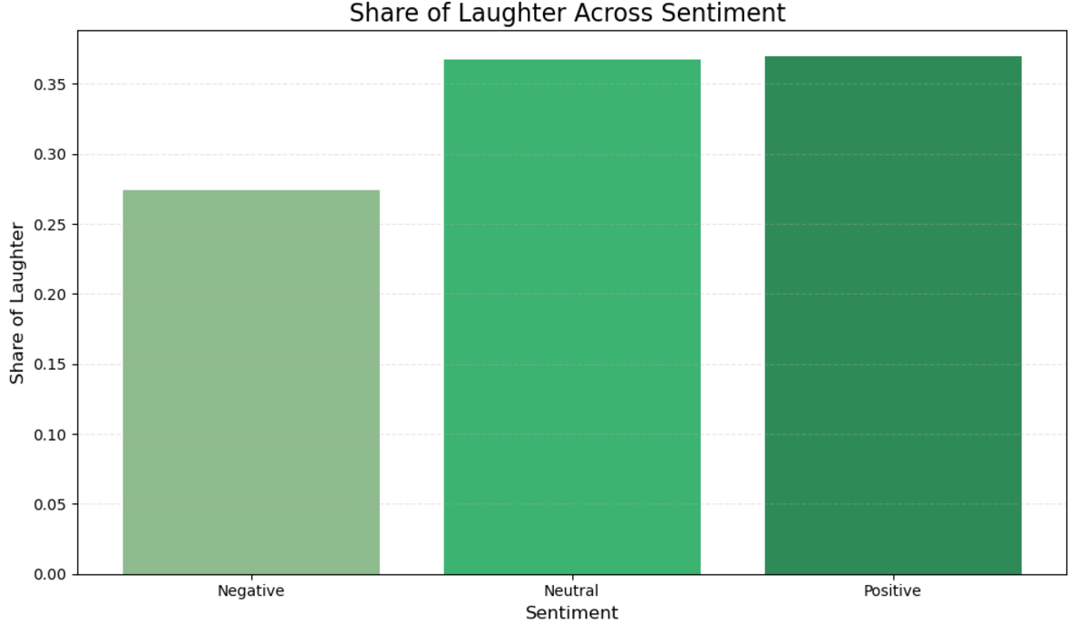
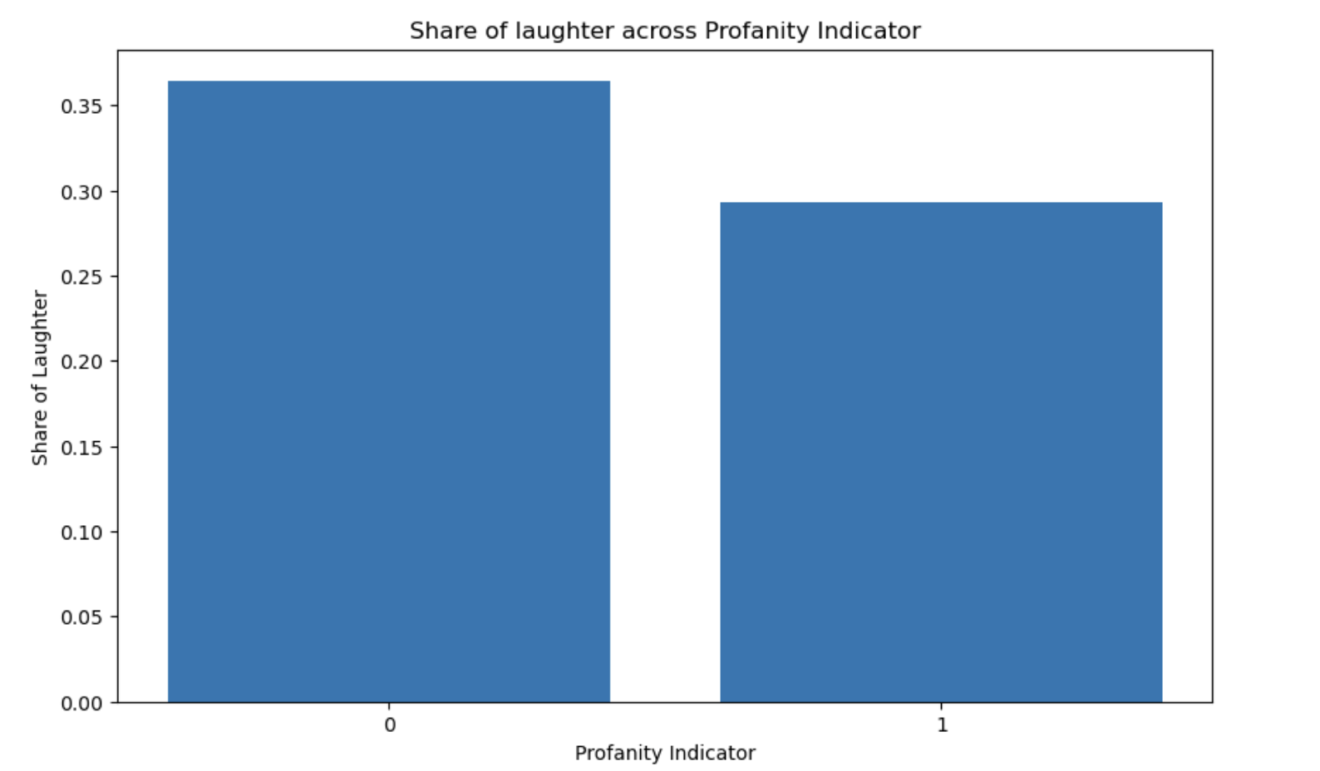
Text Analytics - EDA
Laughter Across Sentiment Types
Profanity and Punchlines: Does it enhance humor?

Slide 12
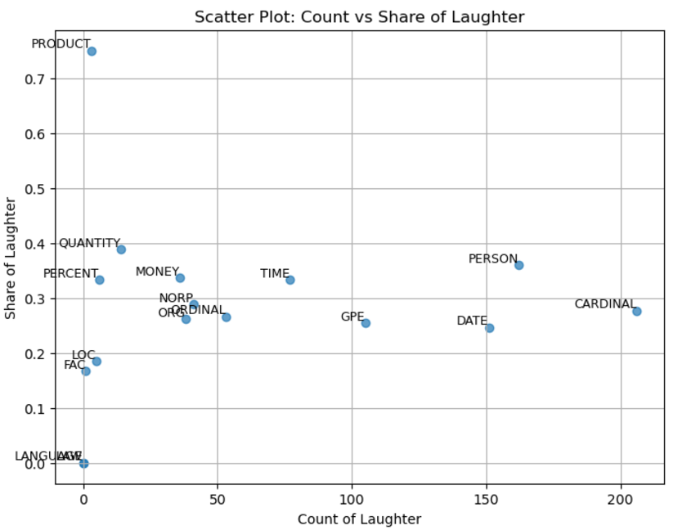
Text Analytics - EDA
Does the presence of certain entity types correlate with laughter?"
An example of label = PERSON
“I think Lil Wayne will die before me
Because he drinks a lot of cough syrup with no symptoms
[laughter] ”
From video ‘Live from Chicago’ - Hannibal Buressï
Notes:
Kedar

Slide 13
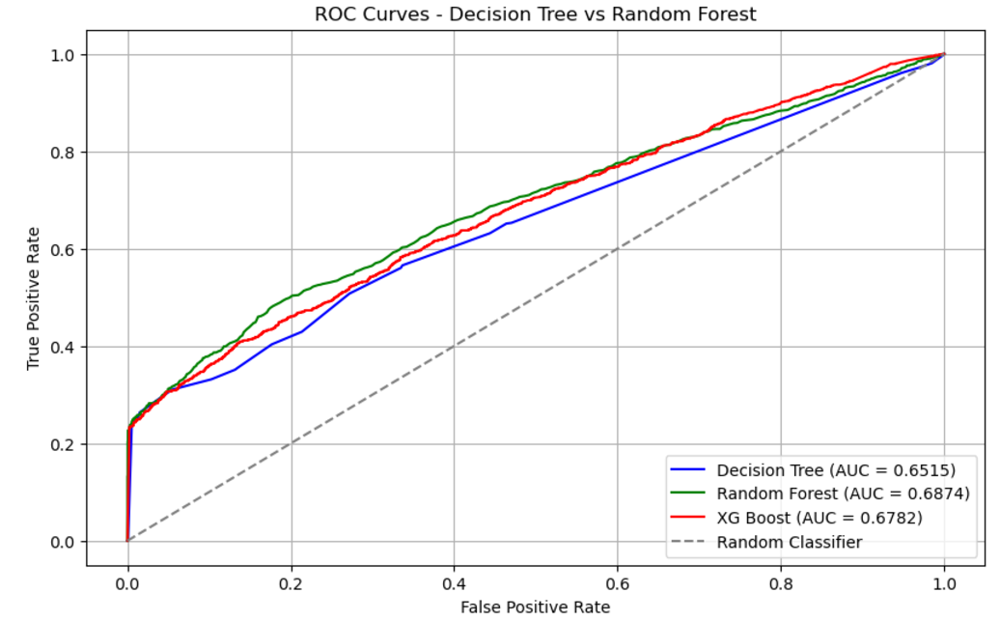
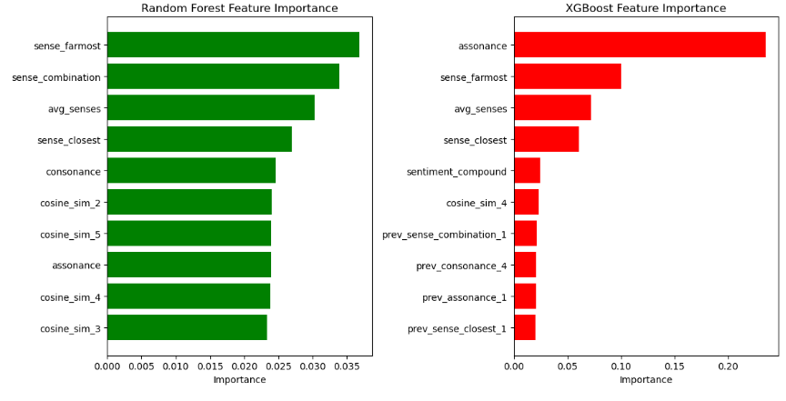
Text Analytics : Feature based tree models
Next Step: Leverage transformers to better capture contextual and nuanced complexities in humor.
Notes:
Kedar

Slide 14
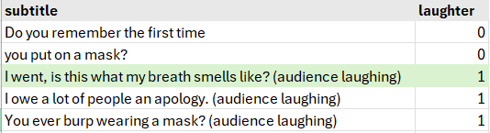
Text Analytics : Deep Networks
Target variable definition
Old Approach:
- Mark 3 lines preceding the marker
as context [1]
New Approach:
- Mark line only with the marker as context [1]
- If word count in a sentence < 5, then combine it
with previous chunk.
Context
Context
An example from video ‘I’m Nervous, Insecure and Squishy’ - Mark Normand
Notes:
Kedar

Slide 15
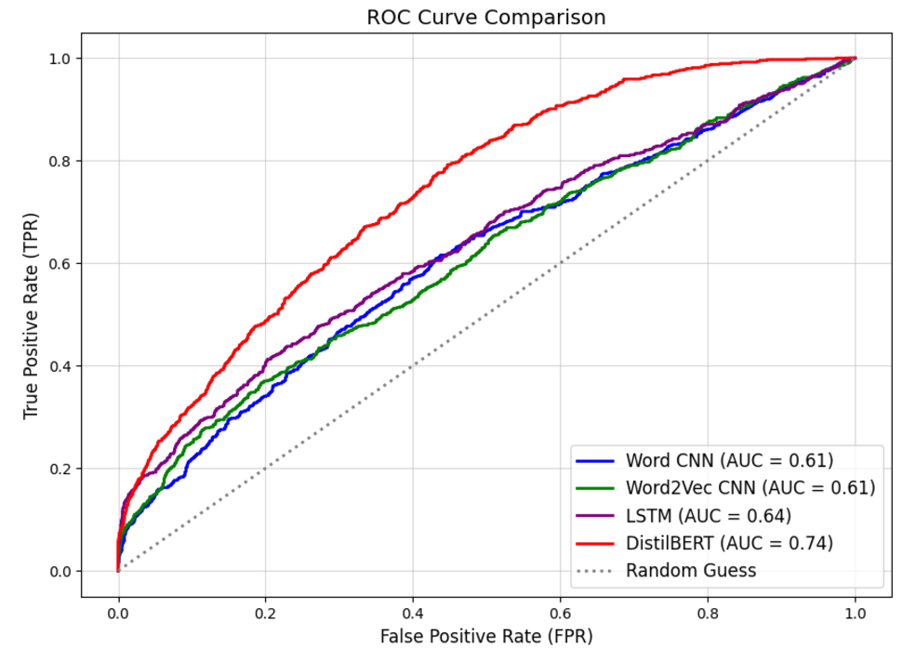
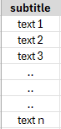
Text Analytics : Performance
Output Classifier
Pre-classifier linear layer
Transformer Layers x 6
self-attention layers x4
Feed-forward neural networks x2
Embedding Layer
Word embedding
Position embedding
Input Layer
Input text

Slide 16
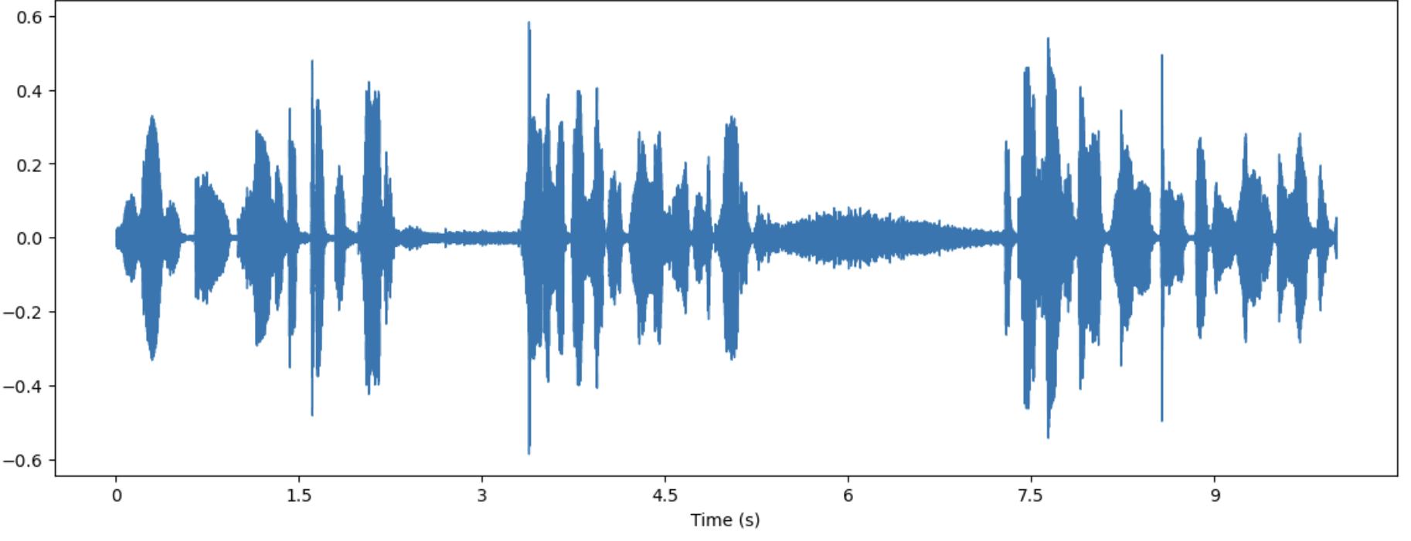
Audio Analytics
Which of the five sections below represent audio laughter?
Waveform of Audio
1
3
5
2
4
Relative Amplitude

Slide 17
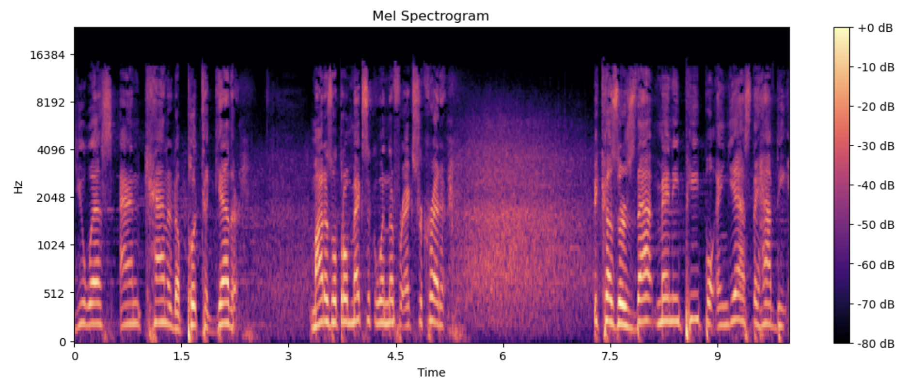
Using higher dimensional representations doesn’t make the task easier.
Turns out, it is challenging to come up with a deterministic rule to annotate laughter in audio

Slide 18
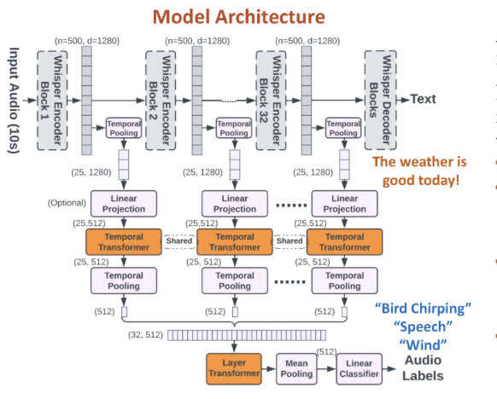
Annotating audio with Whisper AT *
Whisper - AT is built by fine tuning Open AI’s ASR model Whisper
The model, reliably, assigns audio tags {clapping, chirping etc} from a 527 classes for every disjoint 10 second interval
We used this, state of the art, model for annotating Audio with laughter tags
* Reference : Whisper - AT: A Unified Audio Tagger and ASR Model Y.Gong et. al. MIT- IBM Watson Labs
Notes:
Have more points on Whisper - AT’s performance

Slide 19
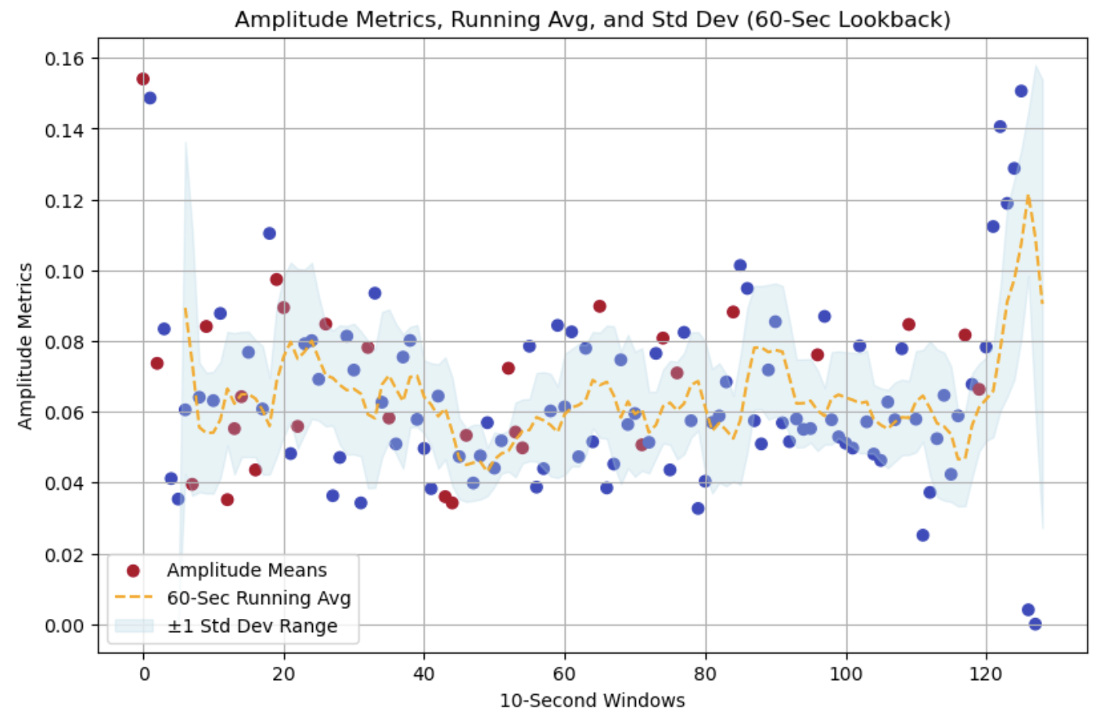


Audio - EDA
Laughter in next 10 seconds interval
No Laughter in next 10 seconds interval

Slide 20
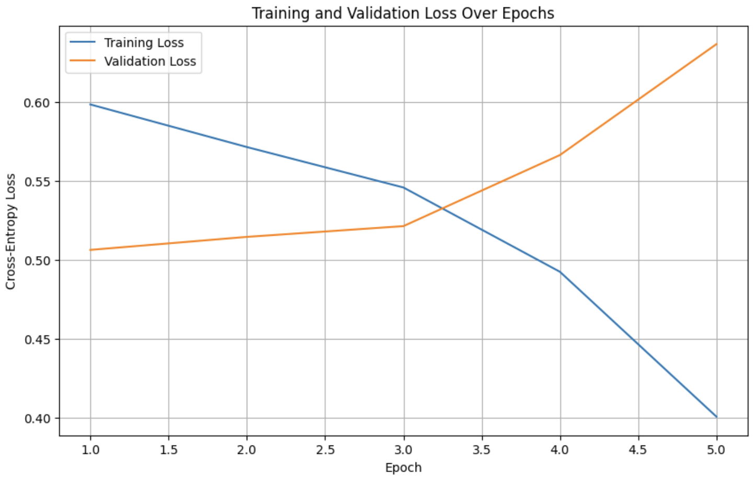
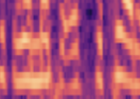
Audio - AST : Audio Spectrogram Transformer
Output
Model | Performance
CNN 3 convolution layers | AUC 50% Pred = Prior of majority class
AST Only Classifier Layer Trained | AUC 57%
Layer 3 (64 -> 1)
ReLu + 30% Drop out
New Classification Layers
Layer 2 (256 -> 64)
ReLu + 30% Drop out
Layer 1 (768 -> 256)
Encoder Layers (12 layers)
Linear Projections
Frozen Layers
Conv 2
Conv 1
Conv n
AST overfits quickly
Input Spectrogram
*AST - Audio Spectrogram Transformer , Yuan Gong et. al.

Slide 21
Audio - Feature Engineering
A simpler modeling approach with engineered features, designed to capture speech modulations:
Dynamic amplitude range (measure of loudness)
Zero crossing rate (key feature in percussion sounds)
Skewness & Kurtosis of Amplitude
Energy Decay
Total pause duration etc, AND
Lookback features (last 50 seconds / 5 windows)

Slide 22
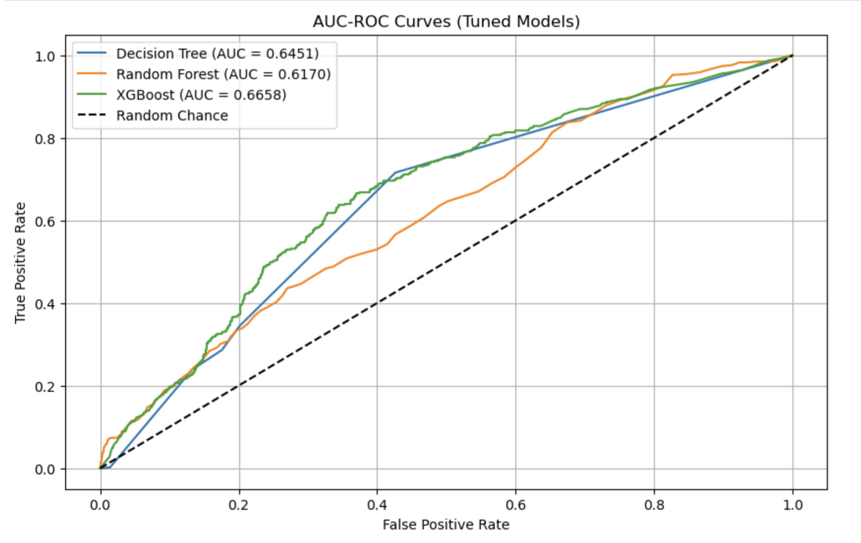
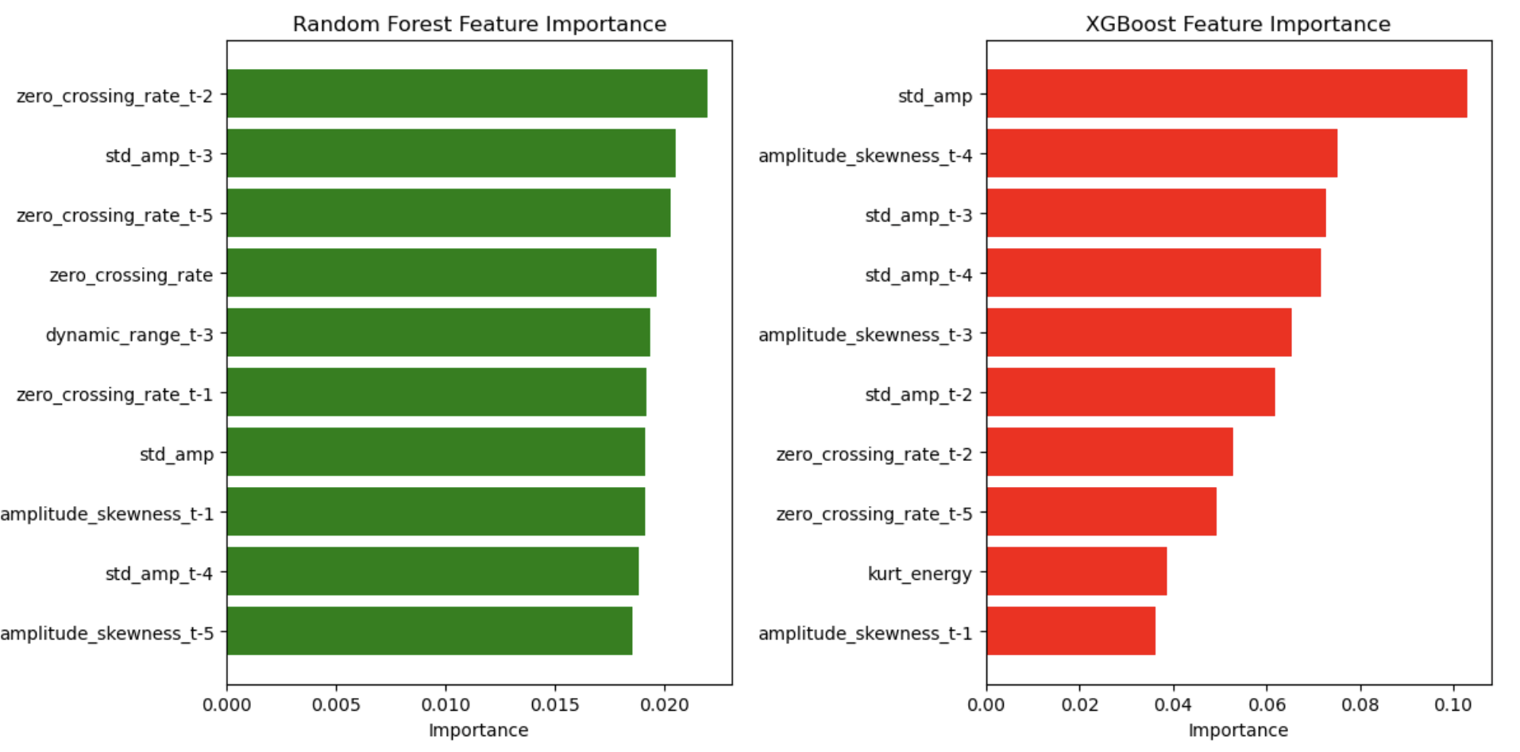
Audio - Performance Comparison
For audio, simpler models are doing better than complex transformer architectures.
Notes:
Call out on ZCR - ZCR may be capturing audience laughter from previous seconds and share information that may not be available in production. A part of future scope if the segregate audience reactions from the speech.

Slide 23
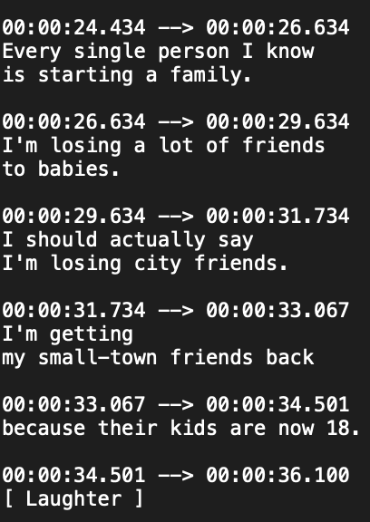
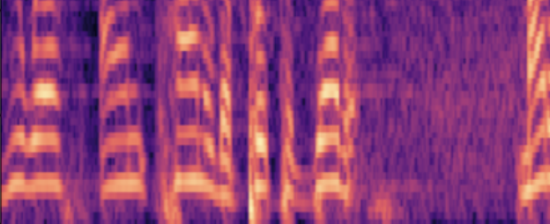
Combining Predictions (Methodology)
Start | End | Pred_1 | target
0:00:24.434 | 00:00:26.634 | 0.20 | 0
00:00:33.067 | 00:00:34.501 | 0.80 | 1
…
…
…
…
Combined Predictions
Start | End | Pred1 | Pred2 | Pred_f | target
0:00:24.434 | 00:00:26.634 | 0.20 | 0.40 | 0.30 | 0
00:00:33.067 | 00:00:34.501 | 0.80 | 0.60 | 0.70 | 1
…
…
…
…
…
…
Start (s) | End (s) | Pred_2*
20 | 30 | 0.40
30 | 40 | 0.60
Subtitles
Spectrogram
*Pred_2 in audio data capture whether people laughed in the next 10 seconds

Slide 24
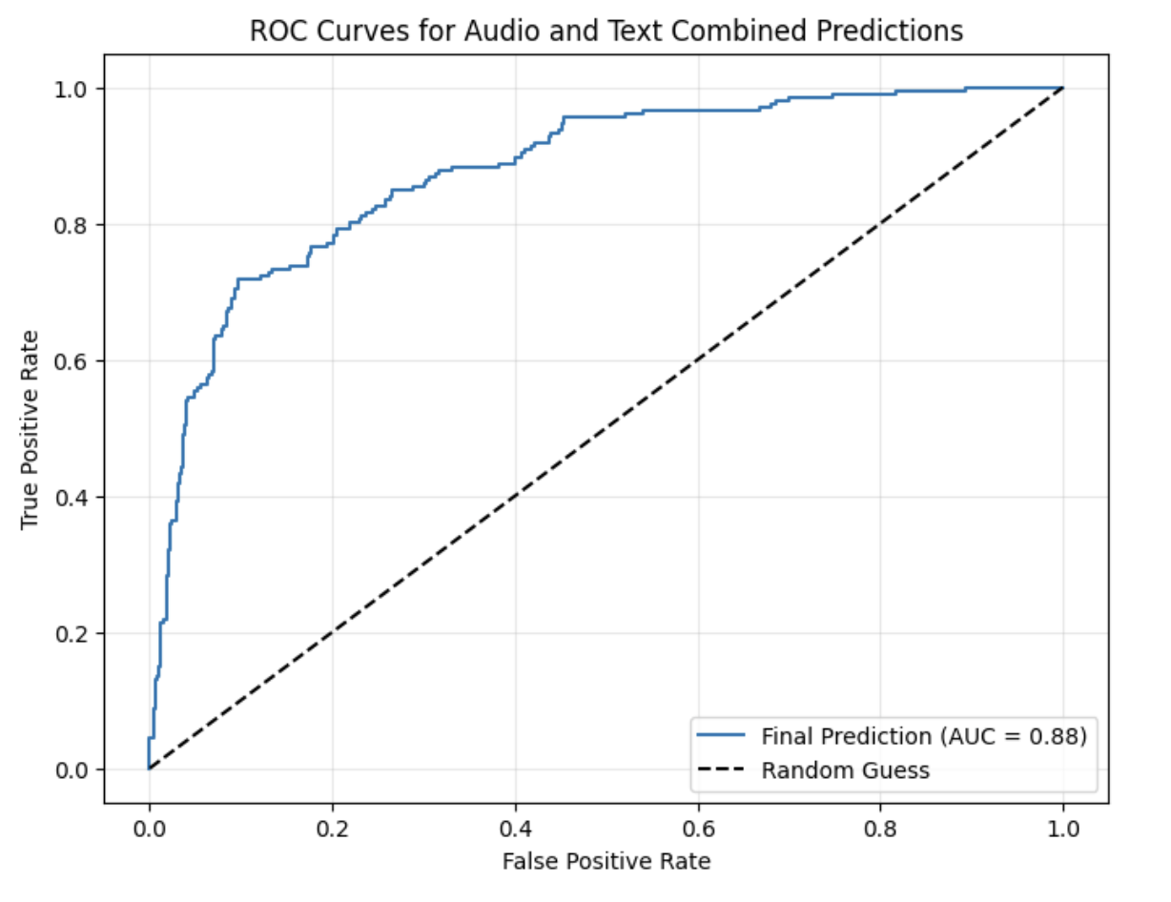
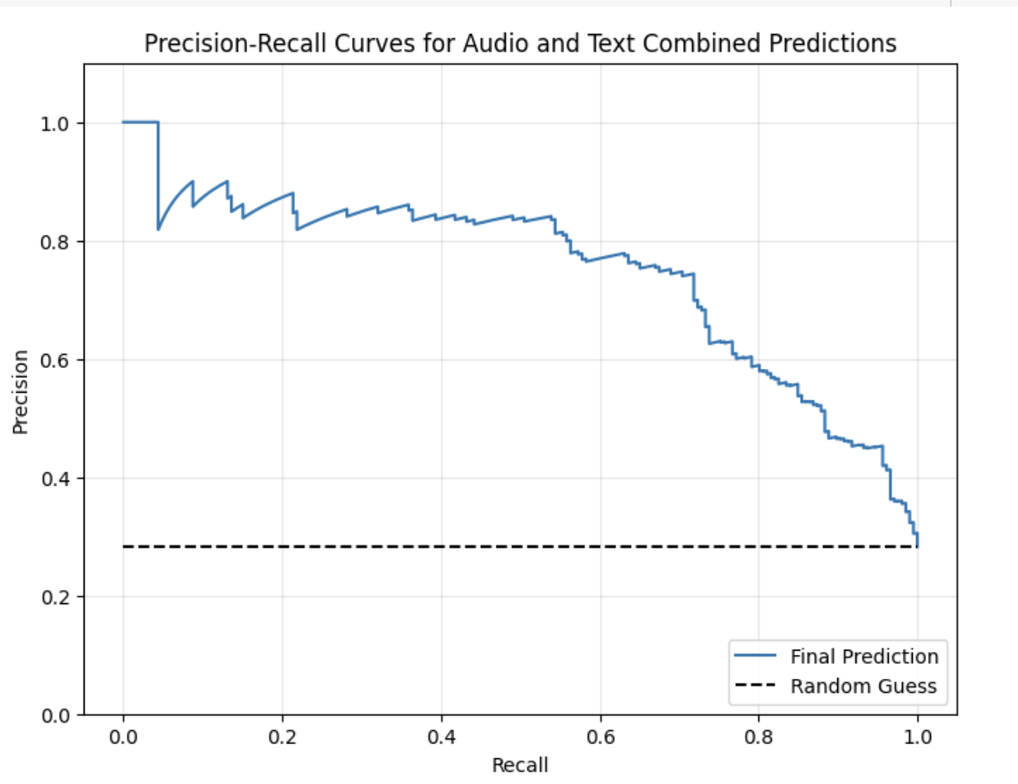
Combining Predictions (Performance)
Data & Model | AUC
Audio (RF) | 66%
Text (Transformer - Distillbert) | 74%
Combined (Separate reserved test data of 13 videos ; Simple averaging of models) | 88%

Slide 25
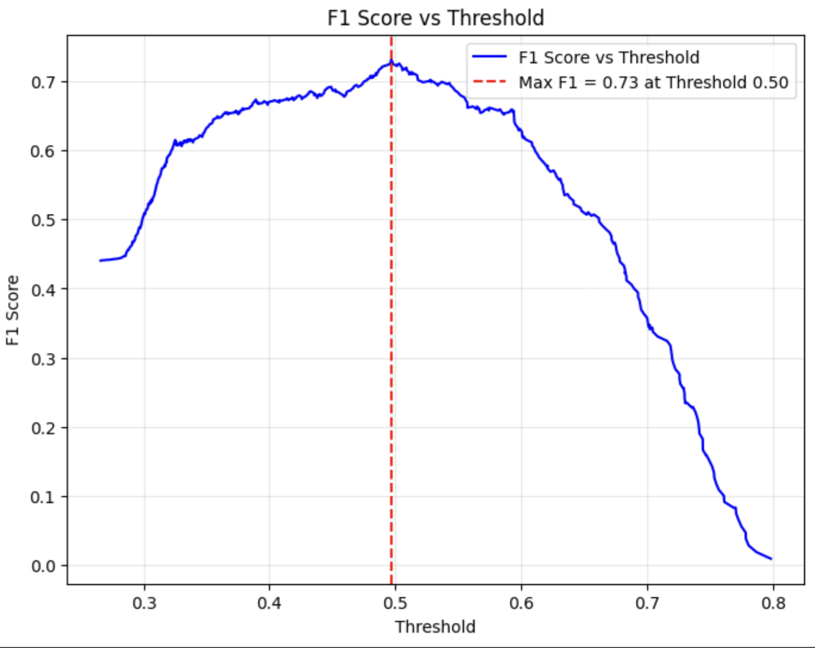
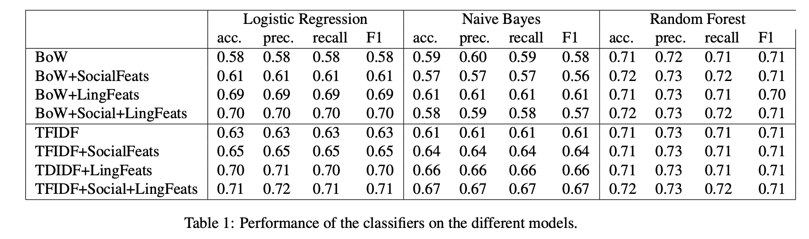
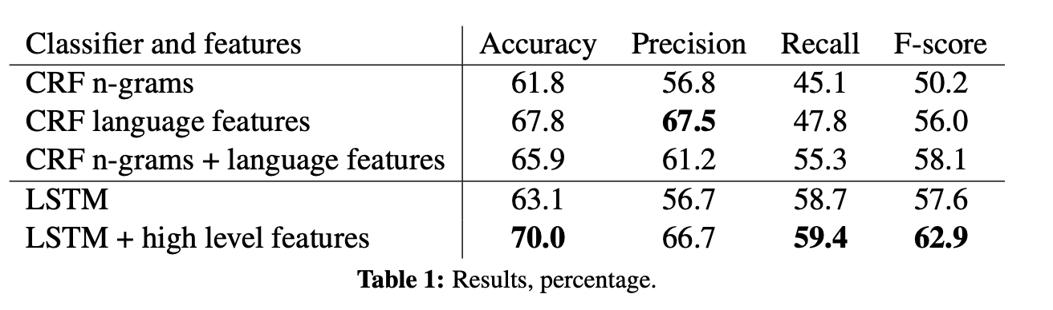
Benchmarking against research
Reference: Analyzing Humor by Turano et. al. (2022)
F1-score of our combined model at optimal threshold
is comparable to leading research
Reference: LSTM Framework for Predicting Humor by Bertero et. al. (2016)

Slide 26
Future Scope
Modeling Scope
Fine tune frozen transformer on audio data, extract audio vectors, use for classification
Whisper-Small with attention layer to combine spectrograms
Production Scope
End Goal - Come up with a tool for struggling comedians to upload their mock scripts or practice audio set, and the tool is able to detect which of the jokes would land (make audience laugh)
Notes:
Modeling- rundown: whisper small model mad 1500 spectrograms for each 10 second chunk. Froze layers and stop before the end (classification layer) to get vectors, use attention layer which is a softmax for the 1500 frames to get one vector for the entire 10 second chunk. Feed these vectors into randomforest model… results not worth sharing
Prod. scope- text format helps comedians choose right words/what to say, audio helps with how to day it
Additional scope - Segregate and remove audience laughter from the preceeding 10 second clips. Currently zero crossing rate may capture laughter of audience from previous clips. This influences the decision of the model about whether people will laugh in the next interval.

Slide 27
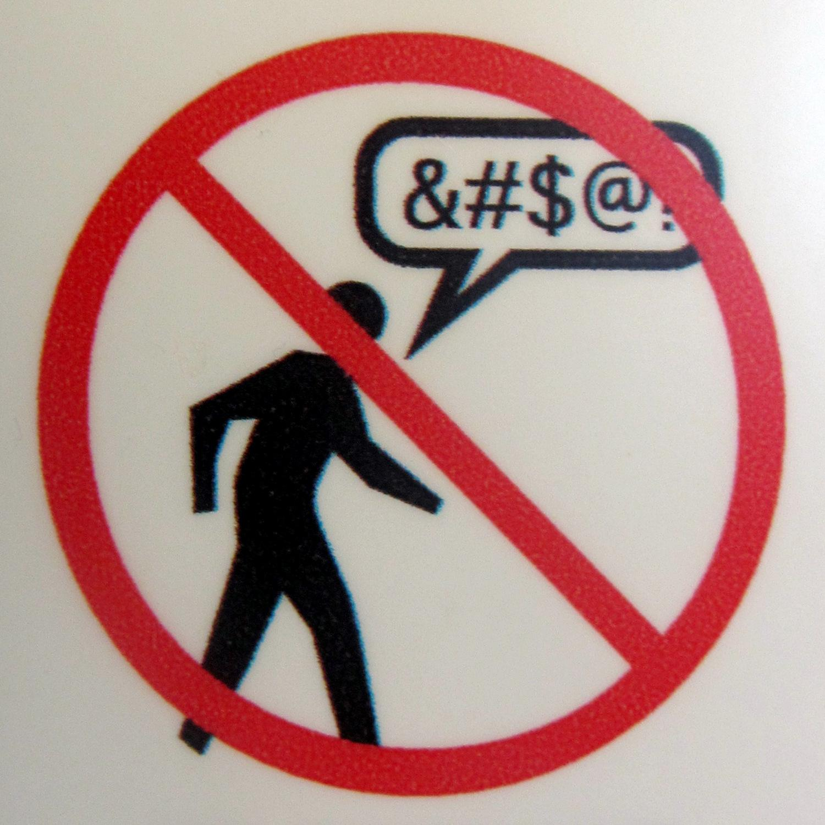
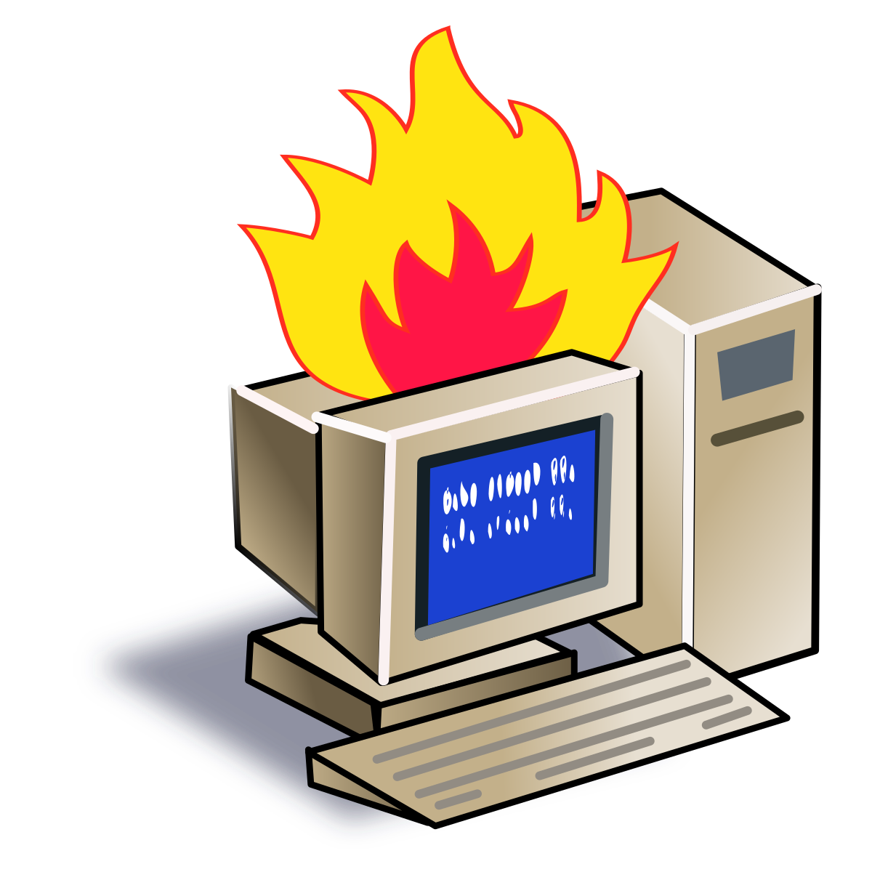
Takeaways
Take your chances with all models!
Audio → Simpler model was better
Text → Complicated model was better
Mind Your Language!
Profanity does NOT necessarily lead to more laughs
Profanity can also limit your audience
Computation is Expensive and Time-Consuming!
Transformers
Converting audio data to mp3 format
Neural network
Notes:
Take your chances (Audio - simpler mode; text - more complex)
More profanity doesn’t lead to more laughter
Computation is expensive, download your models!

Slide 28
Q&A
Thank-you for listening!

Slide 29
Appendix

Slide 30
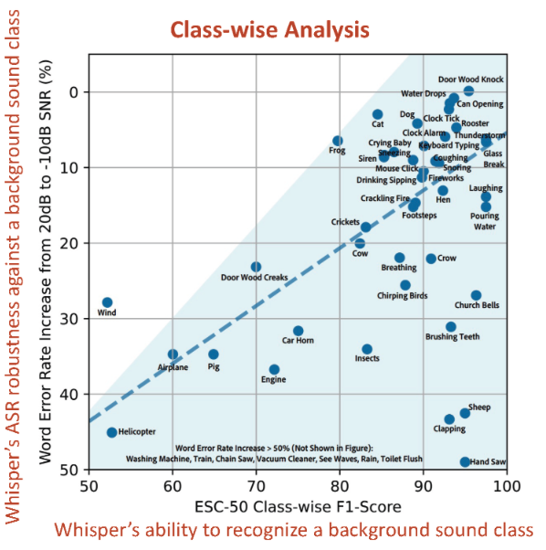
Whisper AT Performance
* Reference : Whisper - AT: A Unified Audio Tagger and ASR Model Y.Gong et. al. MIT- IBM Watson Labs

Slide 31
Table of Contents
Overview
Data - Scraping and Cleaning (Manual subtitles+Why #n videos is sufficient?) - Kedar
EDA
Text Analytics (Tara / Jyoti)
Audio Analytics (Alex /Aman)
1. Audience Education about Audio and challenges
Modeling
Text (Tara / Jyoti)
1. Feature creation 2. Transformer Architecture 3. Model performance (Total 4)
Audio (Alex /Aman)
1. Feature creation 2. Model performance (Total 5)
Mixture of Experts/Combining Analytics (Aman) (Total 2)
Method of combining predictions
Overall performance
Conclusion and Business Insights (Kedar)
Future Work {All}
Q&A

Slide 32
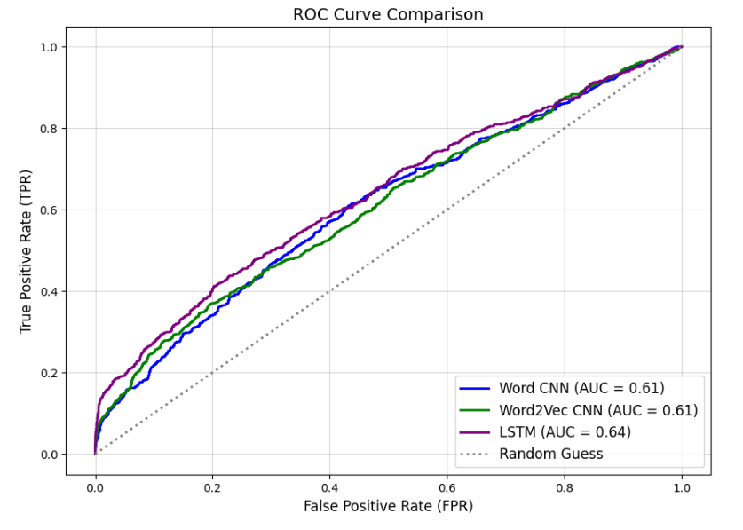
Comparison of different CNN models
Word CNN model with Bag of words approach
Word2Vec CNN model
LSTM model with sequence length 10
Word2Vec structure:
input layer -> embedding -> convolutional layer -> globalMaxPooling -> dense layer

Slide 33
Text Analytics - EDA
Does the presence of certain entity types correlate with laughter?"
The role of "unexpectedness" or "contrast" in driving laughter
Notes:
Kedar

Slide 34
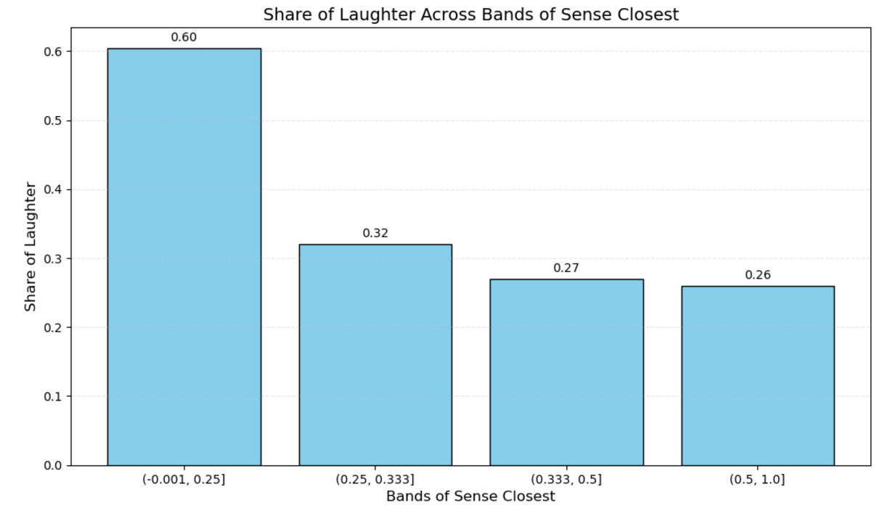
Text Analytics - More EDA
Low Similarity, Big Laughs
Profanity and Punchlines: Does Explicit Language Make Us Laugh?
Example:
“I’m reading a book about anti-gravity. It’s impossible to put down.”

Slide 35
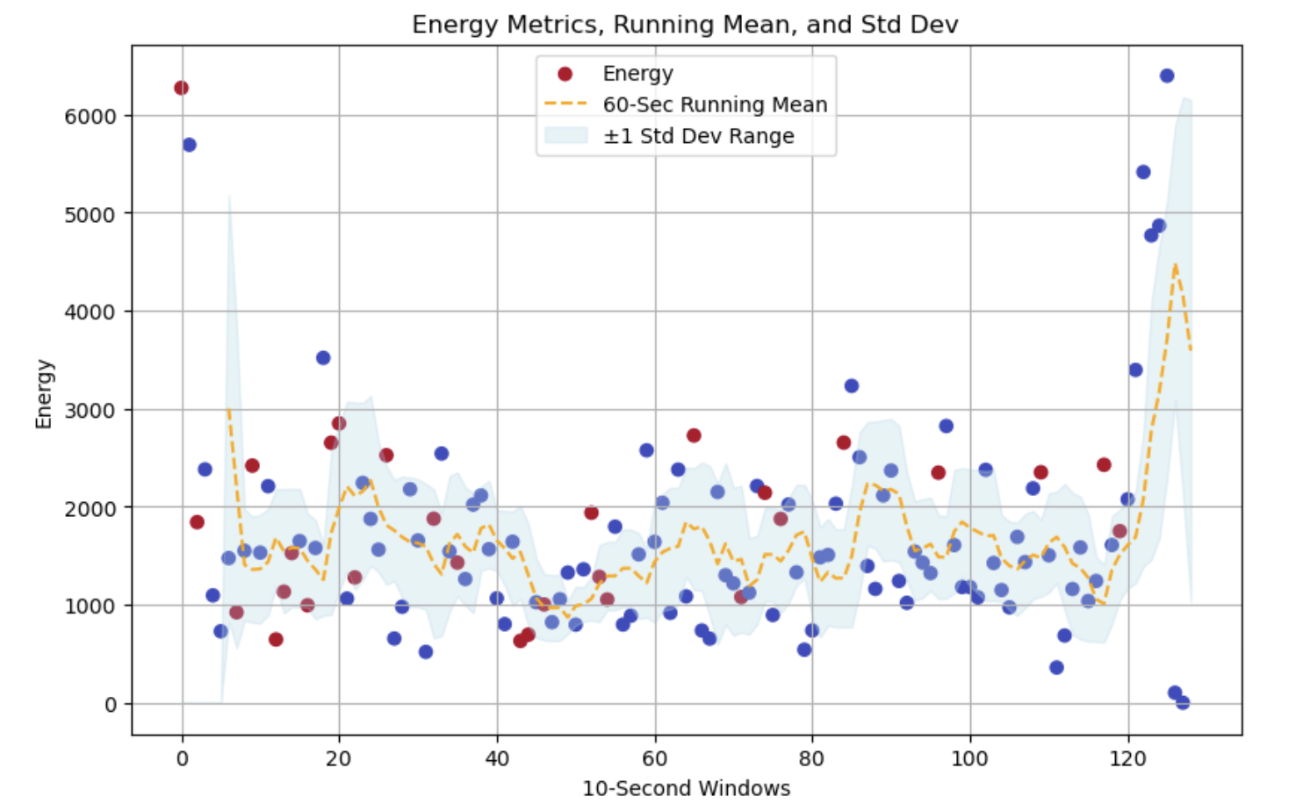
Audio - EDA
Laughter in next 10 seconds interval
No Laughter in next 10 seconds interval

Slide 36
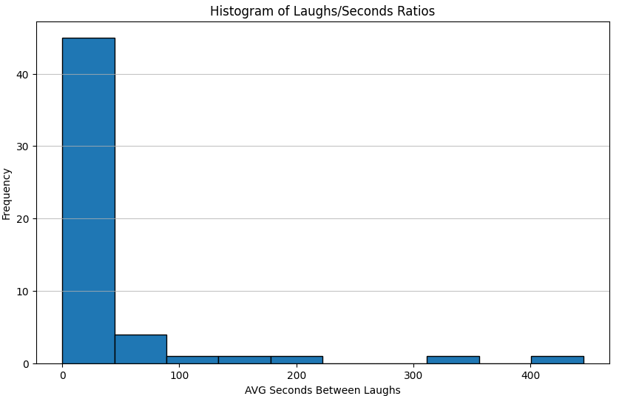
EDA - Seconds per Laugh

Slide 37
Audio - Audio Spectrogram Transformer (AST)
Output
Model | Performance
CNN 3 convolution layers | AUC 50% Pred = Prior of majority class
AST Only Classifier Layer Trained | AUC 57%
Classification Layer
Layer 1 (768 - > 256)
ReLu + 30 % Dropout
Layer 2 (256 -> 64)
ReLu + 30 % Dropout
Layer 3 (64 -> 1)
Fine Tuned Layers
Encoder Layers (12 layers)
Linear Projections
Frozen Layers
Conv 2
Conv 1
Conv n
AST overfits quickly
Input Spectrogram
*AST - Audio Spectrogram Transformer , Yuan Gong et. al.

